Slide 1
苏州科技城外国语学校
首届“伦华杯”英语风采大赛
The First "Lunhua Cup" English Talent Competition of SSFLS

Slide 2
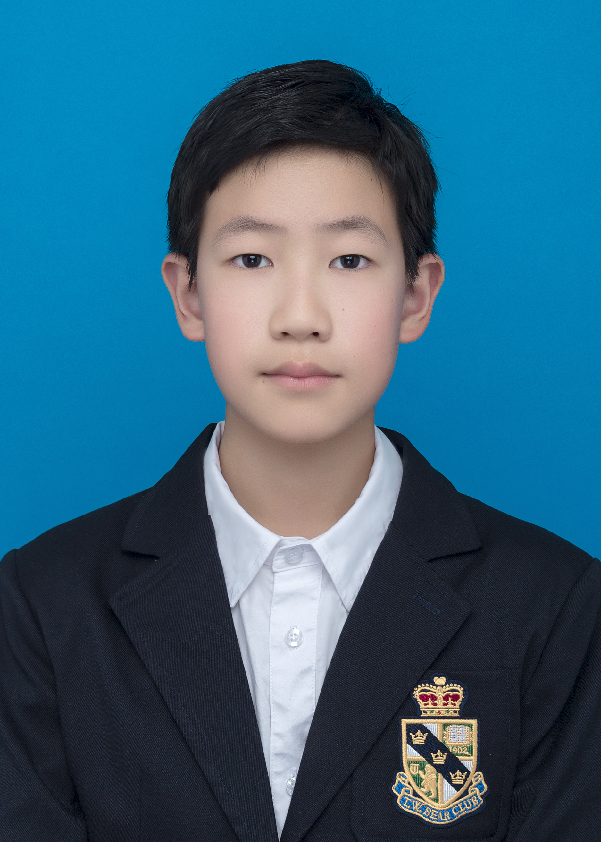
CONTESTANTS OF THE EVENT
张啸泽 Shawn
Honors:
1. First Prize owner of the 3rd ”21st Century Cup ”National Kids English Competition of Jiangsu Province
2.First Prize of SPBCN2020 in Suzhou
3.Second Prize owner of the 12th CYECC of Jiangsu Province
选手照片
建议：
正装或校服
Motto:Learning is hard and persistence is cool.
Tutor: 吴佳 Aria.

Slide 3
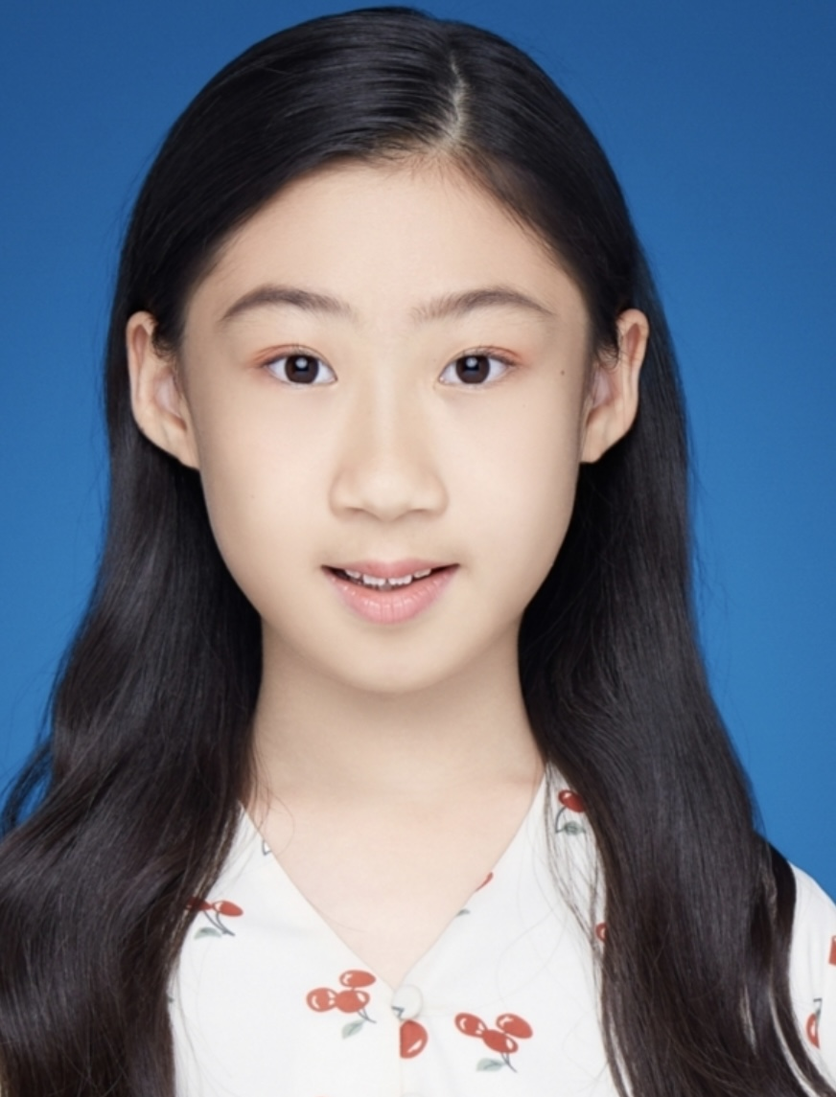
CONTESTANTS OF THE EVENT
胡芮宁 Lucy
选手照片
建议：
正装或校服
Honors:
1. Third Prize owner of the ”21st Century Cup”English Competition in Xuzhou
2. KET149 PET158
3.TOP50 in 2021 Outlook Superstars English Competition
4.Third Prize owner of Stories Of China Retold in English
Motto: Practice makes perfect.
Tutor: 吴佳 Aria.

Slide 4
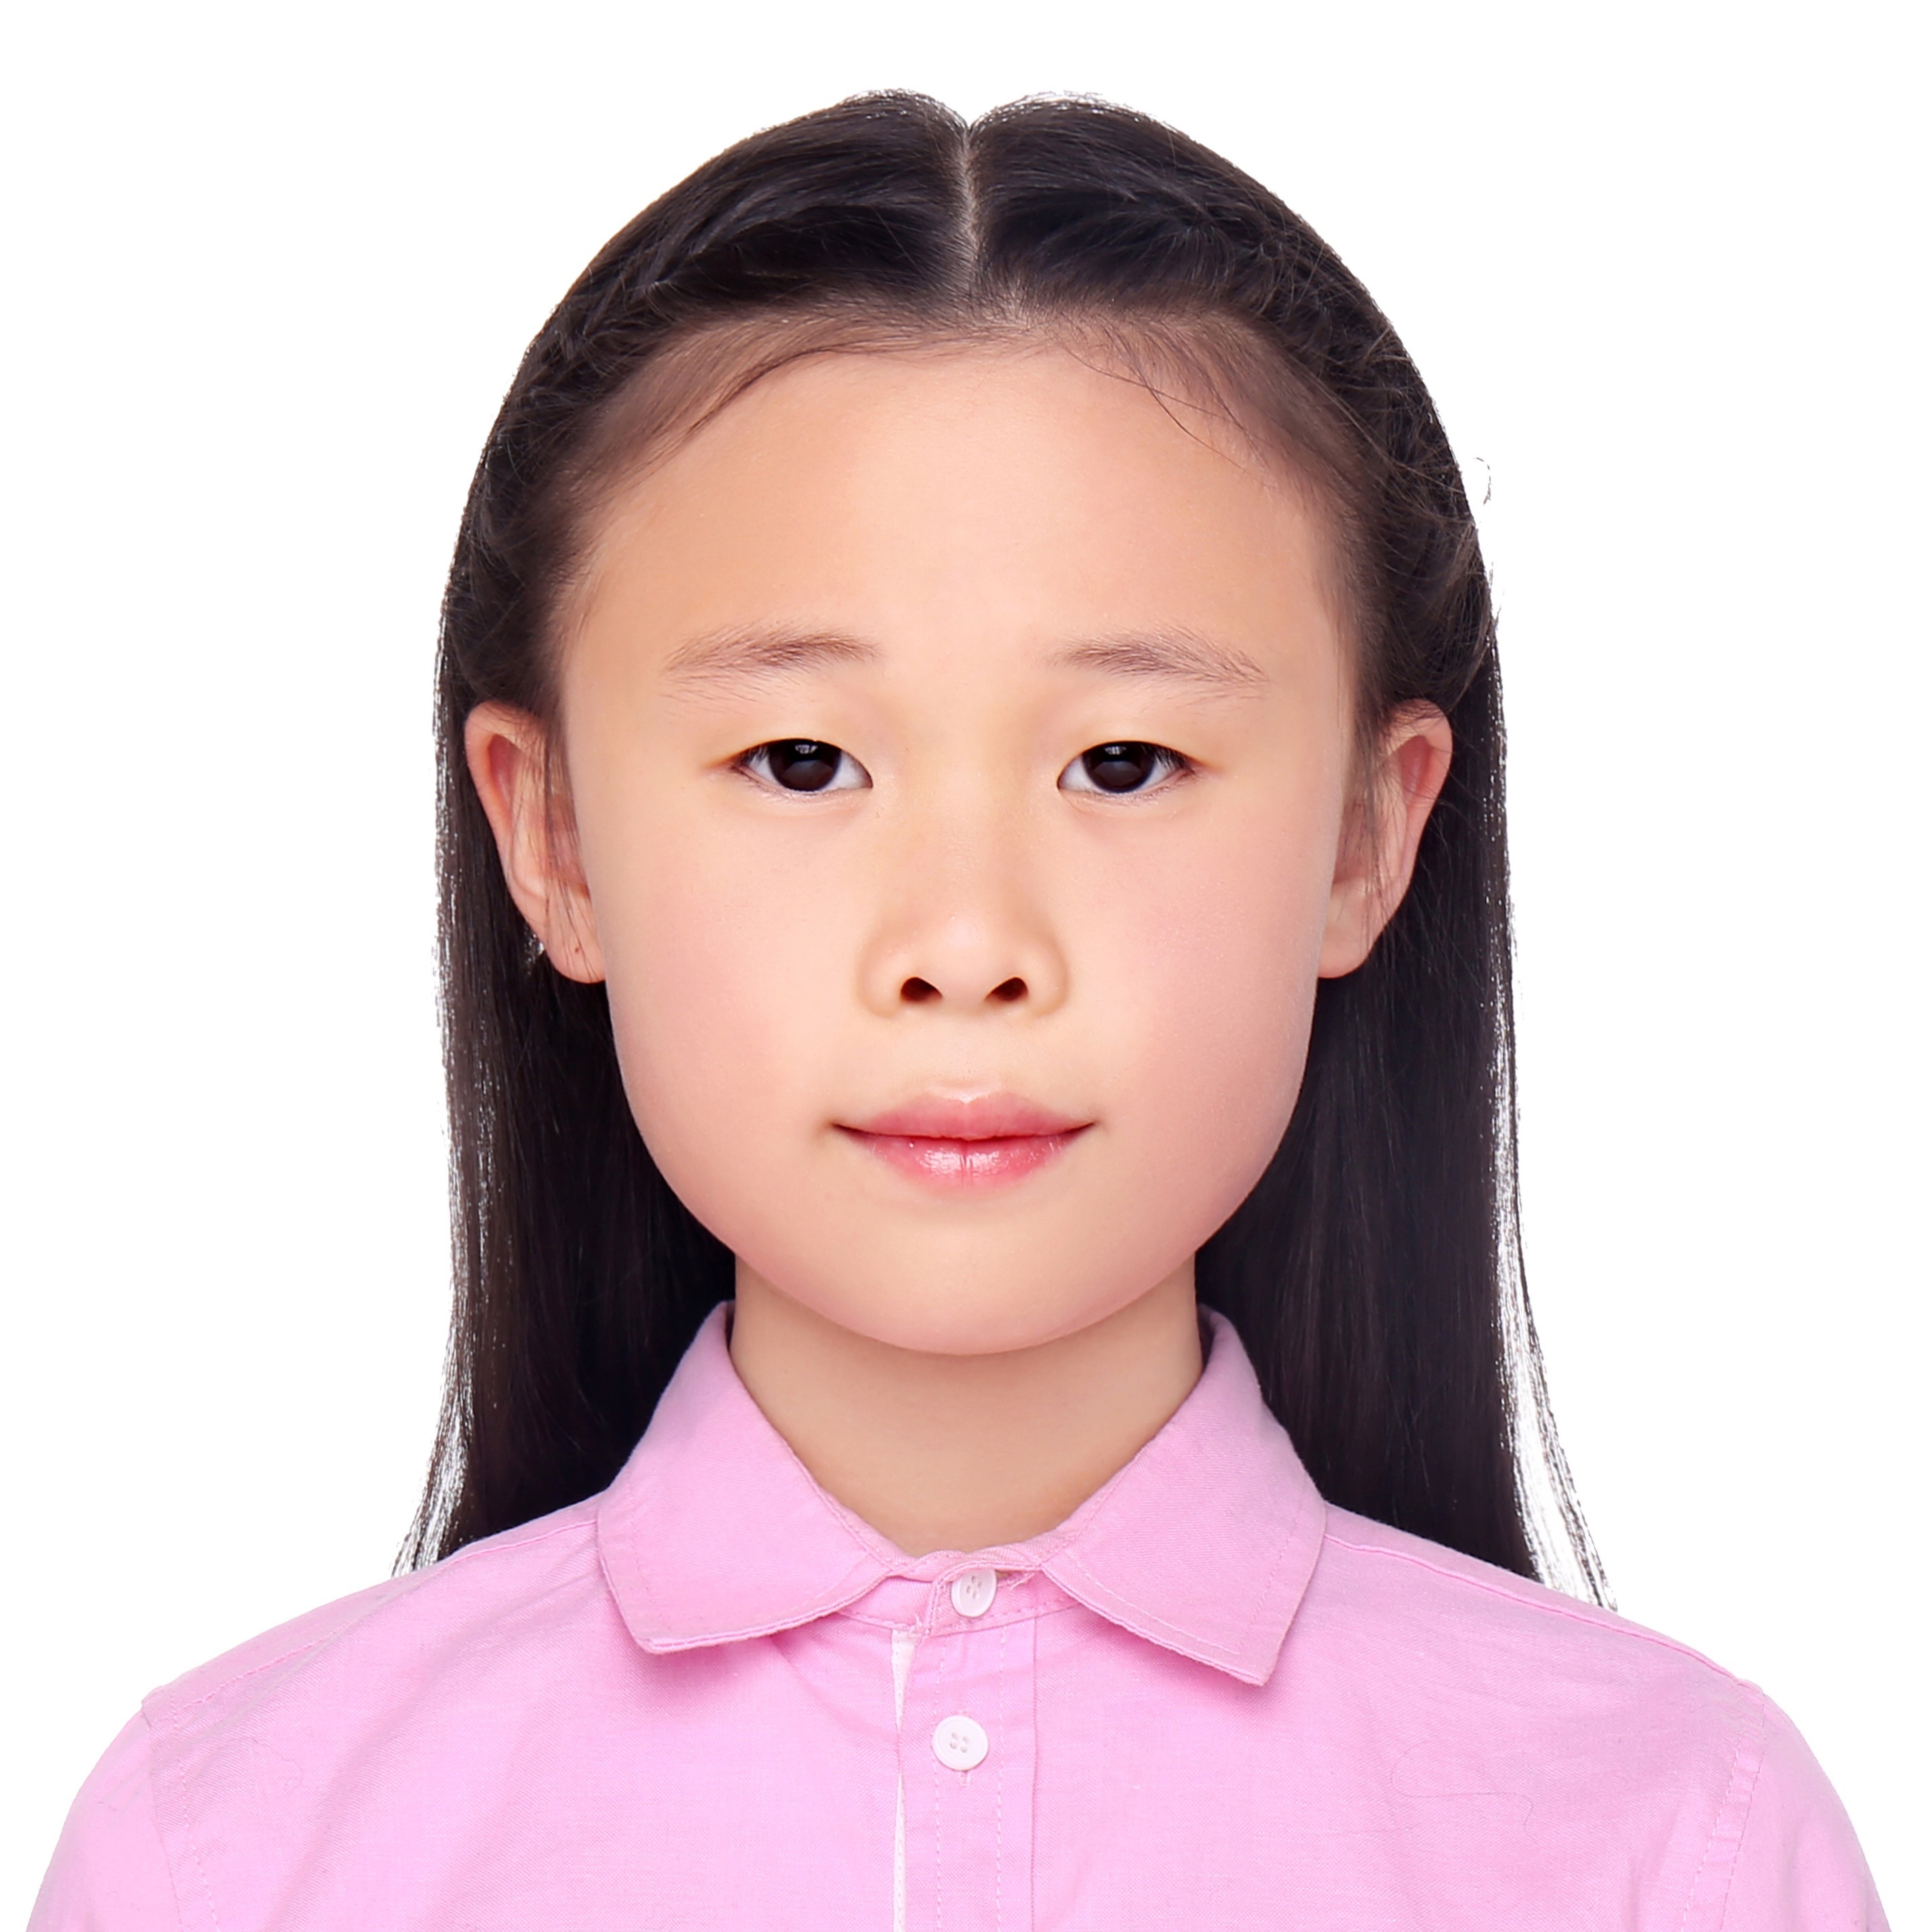
CONTESTANTS OF THE EVENT
陆亭妤 Belinda
Honors:
1. First Prize owner of 2023 Outlook Superstars English Competition
2. Group C-Super Gold Prize Owner of the 2022 "Aesthetic Education Chinese Speech-International Language Arts Conference"
选手照片
建议：
正装或校服
Motto: the slowest step is not to move forward as turtle speed ,but to linger. the fastest step is not to sprint ,but to persevere.
Tutor: 吴佳Aria.

Slide 5
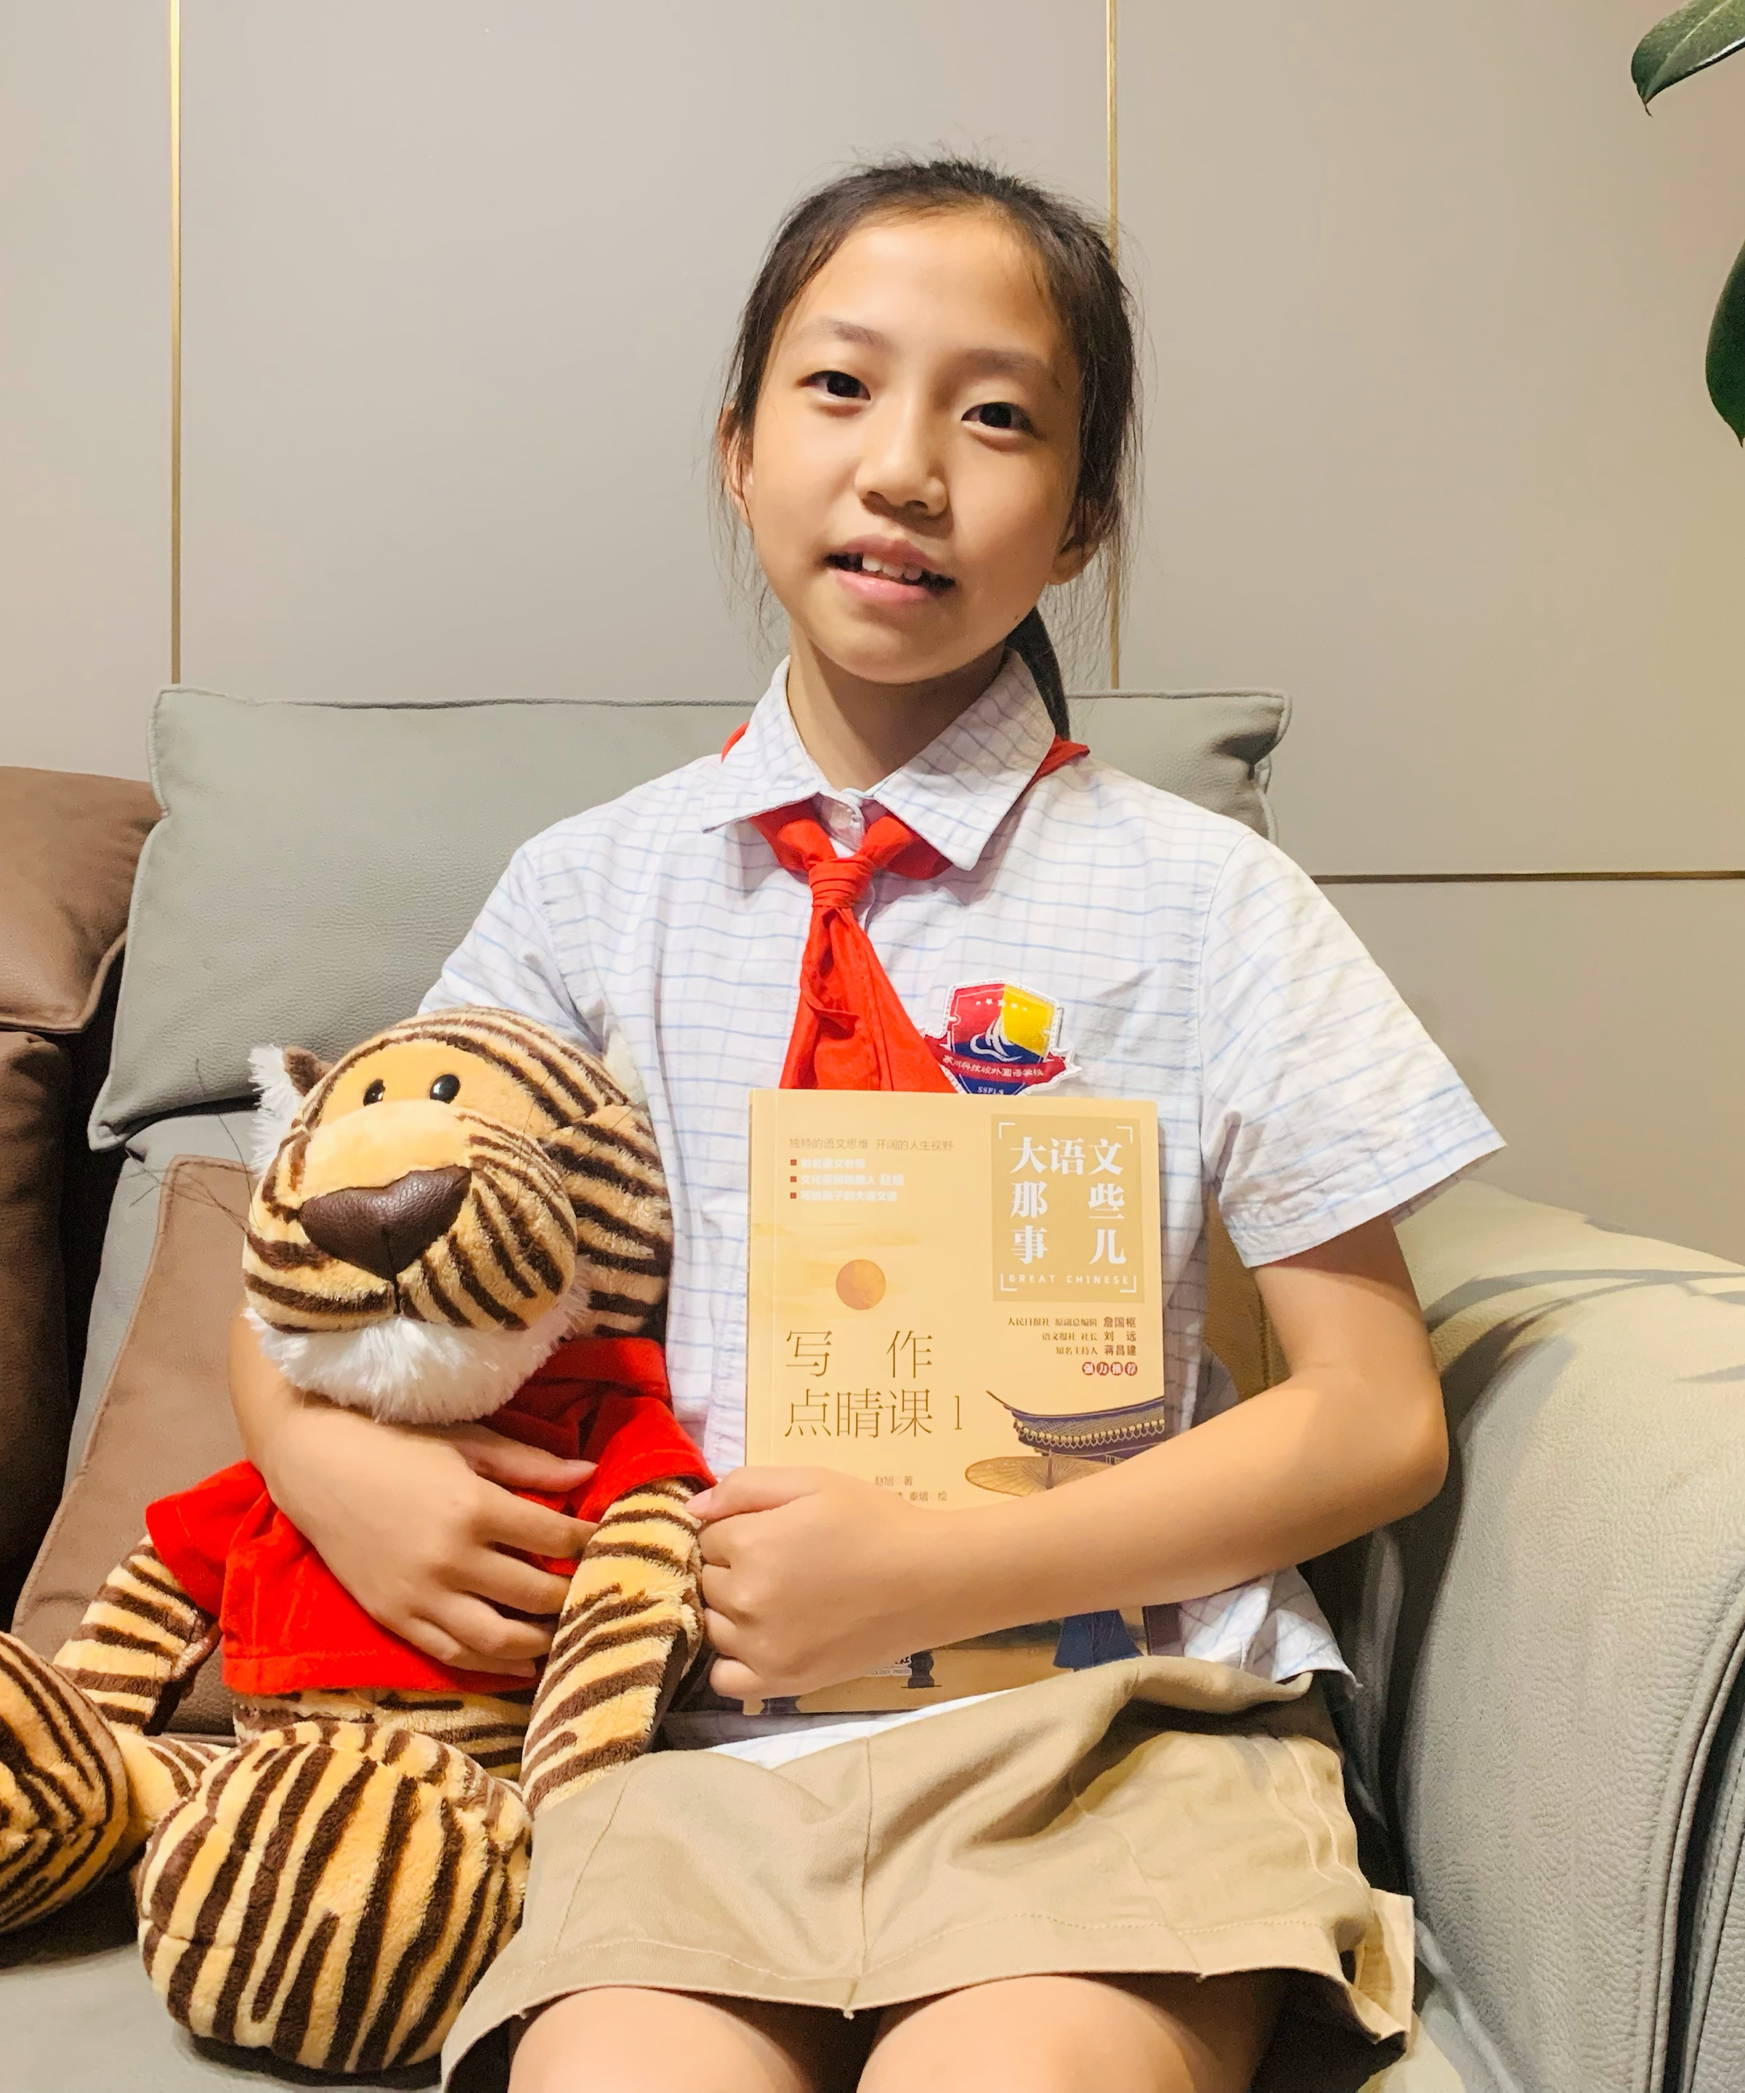
CONTESTANTS OF THE EVENT
吴思虞 Bella
SFC 6J
选手照片
建议：
正装或校服
Honors:
1. The 22nd "Star of Hope and Greek Language Festival" English Talent Competition, Jiangsu Province First Prize。
2. "Aesthetic Education, International Language and Art Conference" National Gold Medal of Grade 5 Group of Primary School
Motto: Learning is like sailing against the current , neither advancing nor retreating .
Tutor: 胡晓昕Twinkle.

